Slide 1
Urbanization
Global Geography 12
Notes:
1

Slide 2
Trend:
There is a growing movement of people from rural to urban areas.
TED Talk:
https://www.youtube.com/watch?v=fKnAJCSGSdk
Notes:
2

Slide 3
Early Civilizations Migrant Communities The First Villages Trading Communities
Notes:
3

Slide 4
As the global population grew:
Incidents of contact increased
Conflict between groups increased
3 Choices: give up land rights, fight, or join their rivals
As the population of a region grew again:
Groups clashed over resources
Groups were to large to pick up & leave
Some chose to fight
Others discovered they could grow crops
With the development of Agriculture: More people could survive on the land

Slide 5
As the global population grew:
Incidents of contact increased
Conflict between groups increased
3 Choices: give up land rights, fight, or join their rivals

Slide 6
As the population of a region grew again:
Groups clashed over resources
Groups were too large to pick up & leave
Some chose to fight
Others discovered they could grow crops
With the development of Agriculture: More people could survive on the land

Slide 7
Migrant Communities
Earliest human groups
Nomadic lifestyle
Why did they live in groups?
- Protection
- Easier to hunt
- Gather food
Notes:
7
Development of agriculture:
Created a stable location
Meant a more regular food supply
Meant Less time need for gathering
Gave rise to the first villages
Allowed villagers to put more time into other activities.

Slide 8
Development of agriculture:
Created a stable location
Meant a more regular food supply
Meant Less time need for gathering
Gave rise to the first villages
Allowed villagers to put more time into other activities.

Slide 9
Migrant Communities
Global population grew
Contact
Conflict
Give up, fight, or join
Groups grew
Clashes over resources
Fight, or agriculture
Notes:
9
Over 1000 years while cities evolved (prior to the Industrial Revolution) the max population rarely exceeded 100 000.
In the 300 years since 300 cities have grown to hold over 1 million people.
We will look at why this might be the case and if the Industrial Revolution did kick start the population growth of cities.

Slide 10
Over 1000 years while cities evolved (prior to the Industrial Revolution) the max population rarely exceeded 100 000.
In the 300 years since 300 cities have grown to hold over 1 million people.
We will look at why this might be the case and if the Industrial Revolution did kick start the population growth of cities.

Slide 11
First Villages
How did the development of agriculture affect the people?
- stable location
- regular food supply
- less time for gathering
- gave rise to the first villages
- more time for other activities
Notes:
11

Slide 12
First Villages
Who were the earliest occupational specialists?
weapons makers & spiritual leaders
How did these specialists survive without hunting/ gathering/ fishing/ growing food?
exchanging goods/services for food
Notes:
12

Slide 13
First Villages
What was created because of this?
intra-village trade
What happened due to the further development of agriculture?
intra-village trade grew
more occupational specialization grew
inter-village trade developed between communities
villages began to depend on other villages

Slide 14
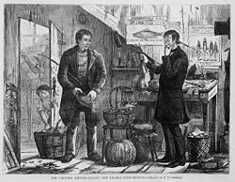
Trading Communities
Intra & inter-village trade created potential for a new profession.
What was it?
Buying & selling goods
What did it lead to?
communities developed to help other communities trade
Notes:
14

Slide 15
Impact of the Industrial Revolution
Ex. mining, forestry, farming, grazing, hunting, gathering, fishing, & quarrying
Notes:
15
Ex. mining, forestry, farming, grazing, hunting, gathering, fishing, & quarrying

Slide 16
Impact of the Industrial Revolution
Improved availability to food
Movement of jobs
Elimination of health risks
Mass transit
Ex. metal working, smelting, textile production, and engineering
Notes:
16

Slide 17
Types of Work Primary Secondary Tertiary Ex. retail, wholesale sales, transportation and distribution, entertainment, restaurants, clerical services, media, tourism, insurance, banking, healthcare, and law
Notes:
17
Ex. retail, wholesale sales, transportation and distribution, entertainment, restaurants, clerical services, media, tourism, insurance, banking, healthcare, and law

Slide 18
Primary Jobs
Extract/ harvest from the earth
Production of raw materials & basic foods
Examples?
Notes:
18

Slide 19
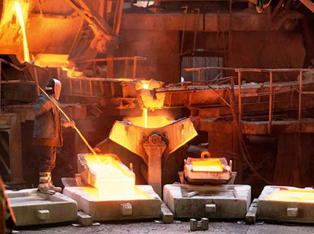
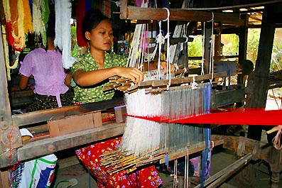
Secondary Jobs
Manufacture/ process/ construct finished goods
Examples?
Notes:
19

Slide 20
Tertiary Jobs
Service industry
Growing sector
Examples?
Notes:
20

Slide 21
Continuum of Classifications of Communities
The earliest occupational specialists:
Weapons makers & spiritual leaders
Highly valued
Exchanged goods/services for food
Notes:
21
The earliest occupational specialists:
Weapons makers & spiritual leaders
Highly valued
Exchanged goods/services for food
Trade created:
Dependence on cooperation among unrelated members.
As agriculture further developed villages grew in size.
Intra-village trade grew
More occupational specialization grew
Inter-village trade developed between communities (needs & wants)
Villages began to depended on other villages

Slide 22
Trade created:
Dependence on cooperation among unrelated members.
As agriculture further developed villages grew in size.
Intra-village trade grew
More occupational specialization grew
Inter-village trade developed between communities (needs & wants)
Villages began to depended on other villages

Slide 23
Hamlet
Population: less than 100 people
Notes:
23
Site Selection: Proximity to resources!
Lack of day-to-day necessities (firewood, adequate water, & protection from the elements) were secondary
If a site did not work out the group would try another site the next year
Longer stays warranted more care in its selection

Slide 24
Site Selection: Proximity to resources!
Lack of day-to-day necessities (firewood, adequate water, & protection from the elements) were secondary
If a site did not work out the group would try another site the next year
Longer stays warranted more care in its selection

Slide 25
Village
Population: 100 - 1000 people
Notes:
Rural areas generally have a population of <1000 people, while urban areas generally have a population of >1000 people.

Slide 26
Rural areas generally have a population of <1000 people, while urban areas generally have a population of >1000 people.

Slide 27
Town
Population: 1000 - 10000 people

Slide 28
City
Population: >10000 people

Slide 29
Metropolis
The chief, and sometimes capital, city of a country, state, or region.
A city together with its surrounding area.

Slide 30
Conurbation
An extensive urban area resulting from the expansion of several cities or towns so that they combine but usually retain their own separate identities.

Slide 31
Megalopolis
When conurbations merge they form a megalopolis.
Some geographers use the terms conurbation and megalopolis interchangeably.

Slide 32
Sources of Urban Growth

Slide 33
Sources of Urban Growth
Natural Growth (births)
Migration (international & internal)

Slide 34
Push Factors
Poverty (LDC)
Living Conditions (LDC)
Lack the variety of Services (MDC)

Slide 35
Pull Factors
Better Job Opportunities
Better Education Opportunities
Better Medical Facilities & Personnel
Greater Availability of Food
Excitement
Fast Paced Life
Access to Cultural Events
Opportunities for Those Without Jobs
(scavenging & begging)

Slide 36
City Life in MDC vs City Life in LDC

Slide 37
More Developed Countries (MDC): City Life
Larger range of goods & services
Major cities never go to sleep
Travel from home to work/school
Entertainment/fun
Slow growing population
Ability to cope with huge population

Slide 38
Less Developed Countries (LDC): City Life
Larger range of goods & services
Major cities never go to sleep
Travel from home to work/school
Entertainment/fun
Housing (fortified mansions – huts)
Rapid population growth
Unable to keep up with needs of the people

Slide 39
Poverty Housing

Slide 40
Life on the Street

Slide 41
Life in the Slums

Slide 42
Life in Shantytowns
Notes:
Improved availability to food
Improved transportation (better roads & canals, trains, trucks)
Food could travel greater distances and still be fresh for the market
Increased amount of land providing food to a local city
Improved food preservation (canning, bottling, pasteurization, use of ice, smoother travelling, better packaging, refrigeration)
Improvements in farm equipment (mechanized farm equipment to increase productivity & land they could cultivate)
Movement of jobs
Majority of people lived on land producing food
Shift
Factories in cities: people could travel easily from work to home
Mechanization of farm equipment: reduced manual labour needed (leaving labourers out of work)
Searched out employment opportunities in factories
Mass produced goods beat out better quality crafts; leaving craftspeople in search of other work.
Elimination of health risks
Pre industrial rev.: close quarters' led to diseases like cholera, tuberculosis, and the bubonic plague
Post industrial rev.: improved handling of sewage & garbage providing save drink water.
Fewer died leading to greater population density
Mass transit
Pre Industrial Revolution: travel limited to size of the city
(walk/take a horse/ live close to places of work)
.Development of streetcars and other mass forms of transit allowed people to live much greater distances from their work

Slide 43
Improved availability to food
Improved transportation (better roads & canals, trains, trucks)
Food could travel greater distances and still be fresh for the market
Increased amount of land providing food to a local city
Improved food preservation (canning, bottling, pasteurization, use of ice, smoother travelling, better packaging, refrigeration)
Improvements in farm equipment (mechanized farm equipment to increase productivity & land they could cultivate)

Slide 44
Movement of jobs
Majority of people lived on land producing food
Shift
Factories in cities: people could travel easily from work to home
Mechanization of farm equipment: reduced manual labour needed (leaving labourers out of work)
Searched out employment opportunities in factories
Mass produced goods beat out better quality crafts; leaving craftspeople in search of other work.

Slide 45
Elimination of health risks
Pre industrial rev.: close quarters' led to diseases like cholera, tuberculosis, and the bubonic plague
Post industrial rev.: improved handling of sewage & garbage providing save drink water.
Fewer died leading to greater population density

Slide 46
Mass transit
Pre Industrial Revolution: travel limited to size of the city
(walk/take a horse/ live close to places of work)
Development of streetcars and other mass forms of transit allowed people to live much greater distances from their work

Slide 47
Do you know of any other examples of poverty housing?

Slide 48
Urban Land Use
- Central Business District (CBD)
- Commercial
- Retail
- Residential
- Industrial
- Institutional
- Open Space

Slide 49
Central Business District (CBD)
The “nerve centre “of cities. Land value is at a premium. Largest concentration of business, tallest buildings.
Examples?

Slide 50
Commercial
Offices and businesses providing services – banks, travel agencies, dry cleaners, restaurants, etc.
Examples?

Slide 51
Retail
Shops selling goods (clothing stores, corner stores, etc.)
Examples?

Slide 52
Residential
Houses and apartment buildings (of various socio-economic status)
Examples?

Slide 53
Industrial
Factories, breweries, blacksmiths, dockyards, bakeries, newspaper printing…)
- heavy and light manufacturing (heavy requires much more space).
Examples?

Slide 54
Institutional
Schools, hospitals, daycares, jails, police/fire stations, theatres, museums.
Examples?

Slide 55
Open Space, Greenbelts
“green space” – parks, playgrounds.
*** Greenbelt is a policy and land use designation used in land use planning to retain areas of largely undeveloped, wild, or agricultural land surrounding or neighbouring urban area.
Examples?

Slide 56
THEORIES OF URBAN STRUCTURE: Models to describe the development of cities.

Slide 57
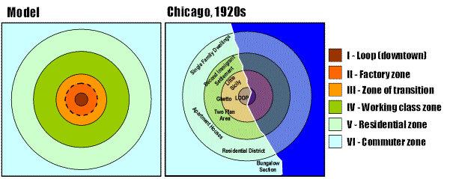
CONCENTRIC ZONE THEORY (Earnest Burgess)
Criticisms of this theory?

Slide 58
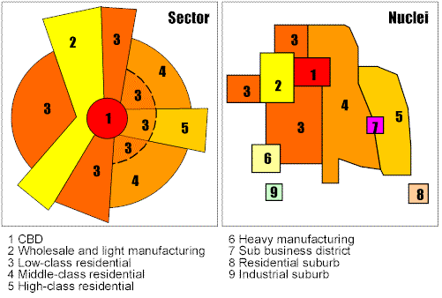
SECTOR MODEL (Homer Hoyt)

Slide 59
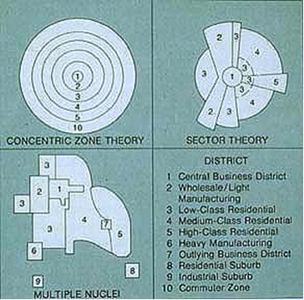
MULTIPLE NUCLEI MODEL (Chauncy Harris and Edward Ullman)

Slide 60
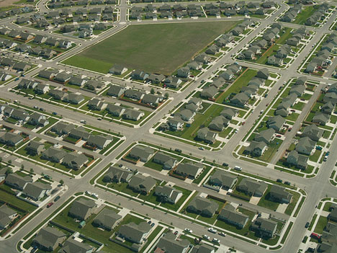
What is Urban Sprawl
Urban Sprawl is a pattern of land use that is characterized by spread out automobile dependant development outside of more compact city centers.

Slide 61
Characteristics
Excessive land consumption
Low population densities
Lack of transportation options
Wide gaps between development and a scattered appearance
Lack of choice in housing types and prices
Separation of uses into distinct areas (not mixed)
Repetitive single family home development
Commercial buildings surrounded by expansive parking

Slide 62
Road Patterns
Older Urban

Slide 63
Road Patterns
New Suburban (Urban Sprawl)

Slide 64
The Process
Land prices decrease as you move away from the city center
Middle class people opt for cheaper homes and a perceived higher standard of living outside of the city
Development jumps the borders of the city
Growth proceeds sporadically and rapidly until city planners catch up.
The car makes it all possible

Slide 65
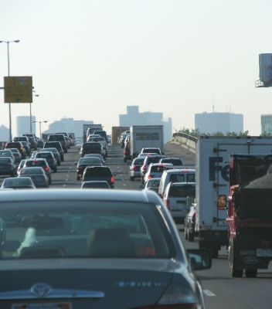
Problems with Urban Sprawl
Land use conflicts
Inefficient land use
Increased energy
consumption and
air pollution
Increase in tax burden
Social impacts

Slide 66
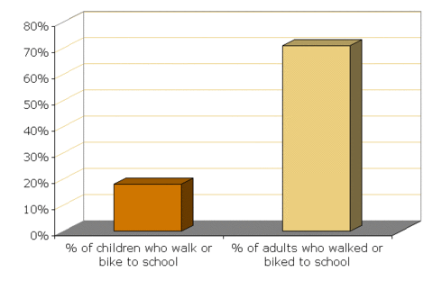
Problems with Urban Sprawl

Slide 68
Problems with Urban Sprawl
Traffic
Cost of living
Pollution
Health

Slide 69
Some Solutions
Tax Incentives
Increased developer fees reflecting the true cost of urban sprawl
Sustainable development
Government intervention
Revitalise existing urban spaces – “New Urbanism”
Greenbelts
Notes:
69

Slide 70
The earliest occupational specialists:
Weapons makers & spiritual leaders
Highly valued
Exchanged goods/services for food

Slide 71
Trade created:
Dependence on cooperation among unrelated members.
As agriculture further developed villages grew in size.
Intra-village trade grew
More occupational specialization grew
Inter-village trade developed between communities (needs & wants)
Villages began to depended on other villages

Slide 72
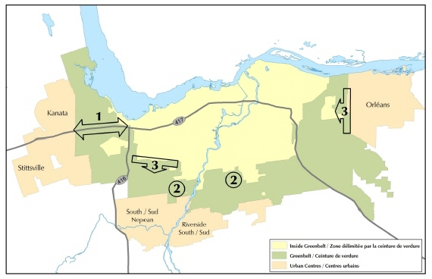
Ottawa

Slide 73
Toronto

