Slide 1
9/17 - 9/18
Have the two questions that were to be completed after your exam out to be checked!!!!
Who were the ‘Big Three’ and what were their goals at the end of the war? (HINT: each had different aims and motives)
What problems faced the peacemakers at the Paris Peace Conference?

Slide 2
ICEBREAKER:
At the end of World War One what problems remained that needed solving?
PREDICT THE FOLLOWING:
Who was to blame for WWI?
And why????
How could future wars be
prevented?

Slide 3
Did the Paris Peace Conference make a sensible settlement?
On 28 June 1919, exactly 5 years after the murders at Sarajevo, which had sparked off the First World War, the most powerful men in the world met in a magnificent palace just outside Paris. The agreement they signed became known as the Treaty of Versailles.
Palace of Versailles

Slide 4
US President, Woodrow Wilson
French Prime Minister, Georges Clemenceau
British Prime Minister, Lloyd-George
What were the aims of the leaders?

Slide 5
US President, Woodrow Wilson
Avoid future wars
Protect the British Empire
Make Germany pay!
British Prime Minister, Lloyd-George
French Prime Minister, Georges Clemenceau
What were the aims of the leaders?

Slide 6
Background on the period
Rivalry over alliances – Britain, France, & Germany
Developed over land claims (Asia & Africa)
Sparked Arms Races – German Industrialization Increased & overtook some markets
Triple Alliance – Germany, A.H. & Italy
Triple Entente – Britain, France, & Russia
USA involvement in Far East (China) & supported Open Door Policy
US poured $ into China to try and slow the influence of Japan in the region
Japan determined to extend influence in Far East…success in 1905 in Russo Japanese war = major power

Slide 7
Post-war expectations
Woodrow Wilson & his Fourteen Points
Suggested that the USA would insist on a ‘just’ peace to end the war
Britain & France would ruin these hopes for Austria – Hungary, Bulgaria, & Turkey
Felt great bitterness at huge human and financial cost of war
Also wanted land and colonies
Italy & Japan who had fought with Allies sought German territory as a reward

Slide 8
Armistice
November 11 1918 Germany signed an armistice agreement
Agreed to hand over naval fleet and war materials
Evacuated all German occupied land in France & Belgium
Turkey (October 30) & Austria Hungary (November 3) signed armistice
Agreed series of conferences in Paris would achieve peace

Slide 9
The personalities: President Wilson
He was restricted by his ideology and his commitment to two key principles:
Internationalism – economic international cooperation
National Self-Determination
He began with political support at home, but by the end of the Conference, he was losing the support of Congress.

Slide 10
The Personalities - Clemenceau
Often known by his nick-name – “The Tiger” – he was old but determined.
He wholly agreed with Foche and the French military, that what was needed was a peace of revenge against Germany.

Slide 11
The Personalities - Clemenceau
Clemenceau understood that France had suffered mightily in the Great War and that recovery would be long and expensive.
Germany must be made to pay.

Slide 12
The Personalities – Lloyd George
Wanted to support Wilson because he knew he would need America for any chance at peace
He won election on slogan though “Hang the Kaiser & make Germany pay”
Chief interest in was protecting British trade routes and colonies

Slide 13
Personalities - Orlando
Vittorio Orlando was the Italian Prime Minister.
Did not speak English which hurt his bargaining ability
He negotiated from weakness as his political support at home evaporated

Slide 14
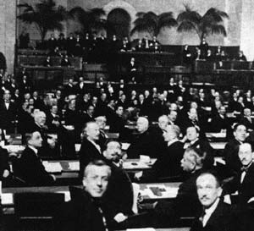
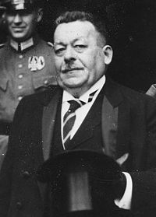
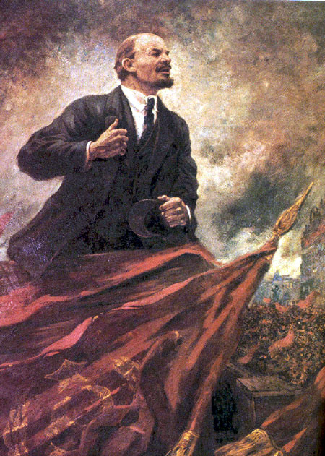
Personalities - others
Winning nations sent delegates to Paris
Had little influence but did have ability to disrupt agreements
NOT PRESENT AT THE CONFERENE!!!!
Germany & Russia
Friedrich Ebert
Lenin

Slide 15
Problems
The Chief problem at the start of the conference was the lack of an agenda.
What would be dealt with first.
No two countries had the same priorities.

Slide 16
A League of Nations?
Wilson was fixated on the idea of forming a League of Nations.
Clemenceau and Lloyd George used this to manipulate him.
They accepted the principle traded for items they wanted.

Slide 17
Defeated Colonies
Britain and its empire wanted colonial issues dealt with.
Wilson favoured an end to colonial acquisitions, favouring a mandate system, where the “civilized nations” would rule over more primitive people only until they were able to look after themselves.

Slide 18
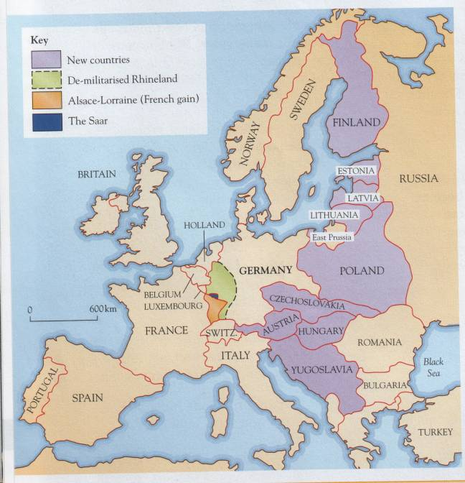
June 1919

Slide 19
Decision time!
1.Alsace-Lorraine should be returned to France
2.Germany could never put soldiers in the Rhineland
3.Saarland taken from Germany
4.Germany split in 2 – Polish Corridor
5.Forbid Germany & Austria to join
6.Reduce size of army, navy & airforce

Slide 20
Decision time!
7.Take away Germany’s colonies
8.Pay for the damage – reparations
9.Sign a War Guilt clause
10.Split Austria-Hungary in two
11.Unite smaller countries
12.Ban Germany from League of Nations
13.No army for the League of Nations

Slide 21
 Your task
Imagine you run a German newspaper that is angry with the Treaty of Versailles. In teams design a front page that includes:
A powerful headline that captures the mood of ordinary Germans
A strong opening paragraph that sums up the treaty
A summary of the main points of the Treaty
An explanation of why so many Germans are shocked and angry
A comment on the Big Three – if you like as a cartoon.

Slide 22
Critical Thinking ~ Assignment
Can you list 3 problems that needed solving at the end of WWI?
Can you name 3 of the main leaders who attended the Paris Peace Conference and their aims?
List 3 things in the Treaty of Versailles that would have angered the German people
How far do you think the Treaty of Versailles achieved its aims?

