Slide 1
Ideology and Nature of Mussolini's Italy

Slide 2
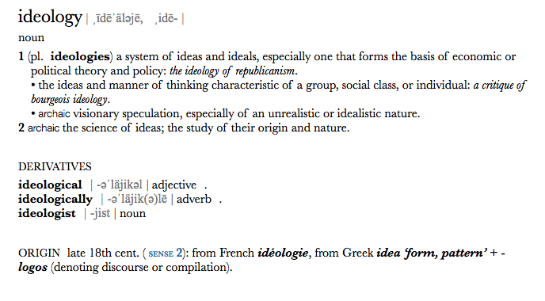
What role did ideology play in Mussolini's rise to power?
- Mussolini had no clear ideology from the beginning
-political ideology ranged from revolutionary socialism (1914) to nationalism and then fascism (1919)
- His rise to power had little to do with his ideologies, main factors that contributed to his rise was the instability in Italy , Violence of the fascist , support of elites, aims and pronouncements
-

Slide 3
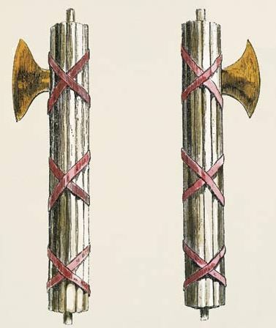
Fascist ideology
Mussolini described it as " action and mood, not doctrine "
HISTORIANS: no coherent and unified ideological root for fascism
Second effort made in 1932 , ten years after Mussolini became prime minister
More of a statement of what fascism was against
AGAINST : liberalism ,socialism , democracy and pacifism, economic conception of history, class war
FOR : action, nation authority ,'state is absolute'
- Funded other emerging fascist party (Fascist International)
- Main factors that contributed was the instability in Italy , Violence of the fascist , support of elites, aims and pronouncements

Slide 4
5 contradictory ideas and beliefs by Alexander Le Grand
National syndicalism - the left of the party - republican and anti- clerical , vaguely socialist
Technocratic Fascism - Modernists , embraced industrial revolution
Rural Fascism - anti-urban and anti - modern ( don’t like the change ) , anti-industrial
Conservative Fascism - Tradition , monarchy and catholic church
Nationalist Fascism - authoritarian imperialist , aggressive foreign policy in order to achieve territorial expansion
Notes:
Conclusion:
In essence, fascism as an ideology, holds no concrete ideas or beliefs, as defined by Le Grand's list. Thus, it may be questioned how ideology, in a state of uncertainty, has supported Mussolini in his rise to power.

Slide 5
To What Extent Was Mussolini a Fascist?

Slide 6
Stages of Fascism
Generic Fascism
Proto- Fascism

Slide 7
Proto-Fascism
The period before the first world war is described as the "incubatory period of fascism".
This early, incomplete form of fascism, which began to emerge before 1919, stemmed from the writings of philosopher Georges Sorel
opposed liberal capitalism.
Many were also unhappy with the parliamentary democracy as it was seen as a way for the wealthy to use politics to take advantage of the lower classes.
The people wanted a strong authoritarian government to replace the weak liberals
Notes:
This early, incomplete form of fascism, which began to emerge before 1919, included elements of syndicalism found in the writings of philosopher Georges Sorel
(1847–1922).

Slide 8
Generic Fascism
Roger Griffin and Stanley Payne's four key elements of fascism
A populist, even revolutionary form of ultra-nationalism
A desire to destroy the existing political system
A belief in a strong leader (the Führerprinzip, or ‘leadership principle’)
A belief in the positive values of vitalism (action) and violence.
Roger Eatwell and other historians find it easier to identify fascist ideology by looking at what they were against. For example, the rejection of liberal ideas of the enlightenment which emphasized rationalism, reason and progress.
Notes:
We think Mussolini should for the most part be considered a fascist due to the fact that he followed the guidelines of proto and generic fascism. Mussolini was in line with Roger Griffin and Stanley Payne's four key elements of fascism, promoting populist ideals, wanting to destroy the liberal government that was in power at the time and wanting to replace it with a strong leader (himself), and a belief in the use of violence. Since there was no clear doctrine for fascism it allowed Mussolini to sway between political ideologies to find what served him best at the current moment.

Slide 9
What was the nature of Italy's fascist state?

Slide 10
Start of the Fascist Party
At first, the fascist party of Italy was a constitute of an incoherent mix of left-wing and right-wing policies. Over 70 different Fascist groups with different ideologies existed throughout Italy.
At least five different factions that wanted a different kind of fascist state in the country.
The enemies of the Fascist party included all the opposing parties.
In 1921, Mussolini narrowed the number of enemies of the fascist party to the socialists and the communist revolutionists, who held imminent revolutions. Began to make positive relations with Capitalist party, Monarchy and the Catholic Church.

Slide 11
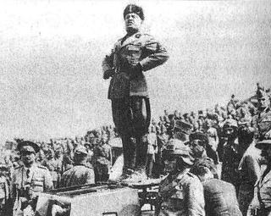
Ruling of the fascist party
The Fascist Party ruled by Mussolini's Dictatorship, which loyalty to the party was highly demanded and there was imprisonment for people who were in suspect to the law.
The party was a personally controlled rather than an ideology controlled party.
Prefacts (career politicians) ruled the government administration, which caused conflicts between local parties and the prefacts.
Mussolini used the conservative elites to contain and maitain law, which he used groups such as the police, judicial system, civil service and the army to do so.
Party posts were mostly appointed from the ones with power, not through election.
Mussolini consistently intervened in the decisions made by the court, and decided upon himself, who to employ for judge.
Wanted every person in italy to follow him without any opposition.

Slide 12
The membership of fascist state
In 1926, Augusto Turati opened membership to other parties' members who couldn't go further in their career. Since this new policy, the party membership rose from 640,000 to 940,000 in just one year.
The oarty had 5 million members by 1943, but most were inactive
The party consists of mainly white-collar and very few peasants (Party became a loyal base for Mussolini)

Slide 13
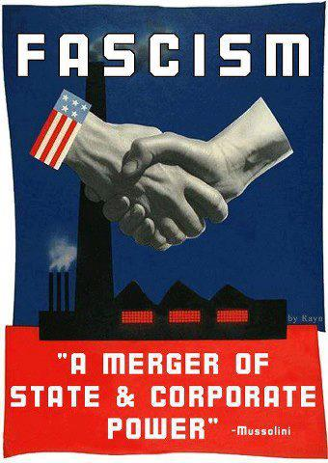
Corporative state
The fascist party was also known as the corporative state, because it consists of equal representations of employer and employee to avoid strikes. This was to help to secre the intrest of the nation.
The Vidoni Palace Pact respectively that the Confindustria and the Confederation was the only parties to represent the employees. Workers were not able to challenge the authority of employees and managers.
In 1926, strikes by all types of workers were abolished and internal disputes had to be settled in local courts.
The Ministry of Corporation (with Mussolini being the minister) guaranteed fair judgement of labor dispute, improved health care and accident insurance scheme.
Notes:
We think that Italy's fascist government was ruled by Mussolini's extreme dictatorship, and espeically the minority, who consisted the top of the government, which these people made important decisions even in places like the court.

Slide 14
Conclusion
Ruled by Mussolini's extreme dictatorship (especially the minority).
After Fascist membership is open for other parties in 1926, its number grew significantly
The fascist state is also a corporative state for the interest of the state

