Slide 1
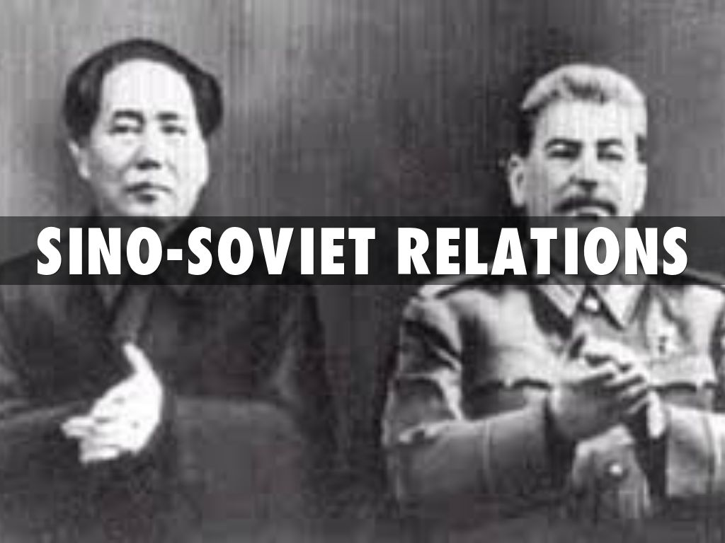
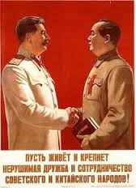
How did Sino-Soviet Relations change during the Cold War?
L/O - To identify and explain the reasons for the key turning points in Sino-Soviet Relations

Slide 2
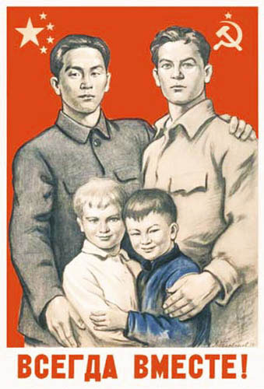
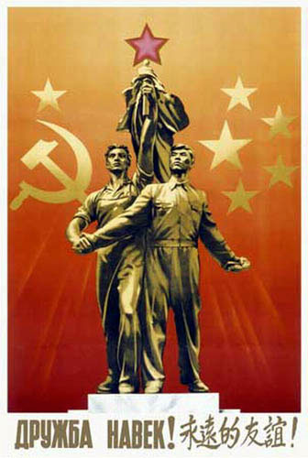
Sino-Soviet Relations in the Cold War
As two Communist nations, you would have expected the USSR and PRC to be allies during the Cold War against American ‘imperialism’.
In the 1950s, both nations formed an alliance pledging mutual support for each other. However the relationship declined in the 1960s, culminating in a brief border war in 1969. China even sought closer relations with the USA!
It wasn’t until the late 1980s when relations began to finally improve again. They key question for historians is why did the Sino-Soviet relationship break down?

Slide 3
Reasons for the Breakdown in Relations
Historical Differences – Russia had seized Chinese territory in 19th century, Bolsheviks seized Outer Mongolia in 1920s, Manchuria stripped of $2 billion in equipment after WW2, USSR had supported KMT in 1920s/30s.
Ideological Differences – Mao and Stalin differed over interpretation of Marxist revolution, Stalin opposed Mao’s rise in CCP, argued over ‘continuing revolution’.
Political Differences - Mao opposed Khrushchev’s ‘peaceful co-existence’ policy, sought independence from Moscow, USSR only gave conditional support during Korean War, both sought leadership of international Communist movement.
Economic Differences – Argued over how to develop Chinese economy, Great Leap Forward failure, China had to pay for aid
Military Differences – USSR was reluctant to give China military aid and nuclear technology, China suspicious of this.

Slide 4
Mao’s Foreign Policy Priorities in 1949
The source of disagreements can be traced back to Mao’s aims which were essentially about ‘national’ survival rather than helping the USSR:
Economic Development – China reluctantly relied on Soviet aid and expertise to re-build, internationally isolated at UN, Western trade embargo since November 1949.
Territorial Integrity – China needed to secure its control over outlying provinces like Tibet and Taiwan. Feared hostile forces on its borders in Vietnam/Korea, needed Soviet protection initially
National Identity – Maoism was not just about world revolution but restoring the Chinese nation and re-dressing past humiliations, including Soviet domination. Mao wanted independence of action.
International Revolution –Mao believed that war with Capitalism was inevitable. Communist revolutions should be encouraged world-wide. USSR didn’t want this after 1956.

Slide 5
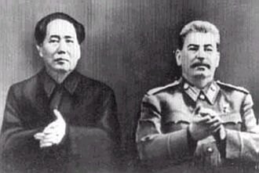
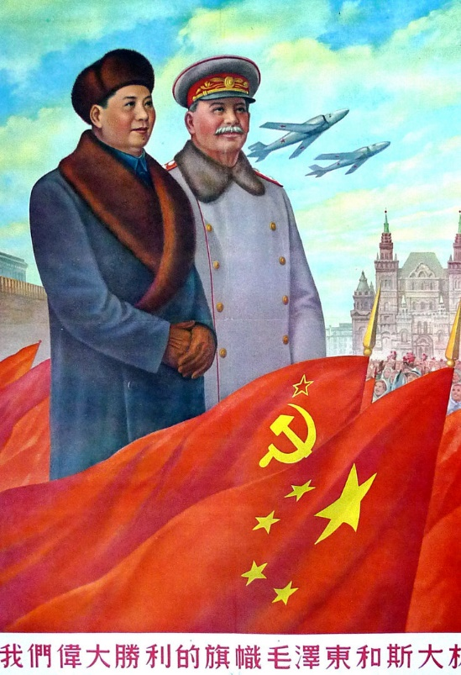
Ideological & Personal Differences
Stalin and Mao had a history of disagreements even before 1949. Stalin believed that the KMT were better placed to re-unify China and supported them even in the 1940s. Mao believed that Stalin wanted a weak China that he could dominate.
Mao’s interpretation of Marxism focused on using the peasants as the revolutionary class. Stalin believed that this was wrong, revolution should be based on urban working class.
Stalin also was mistrustful of any rivals with the Communist world and did not want to spread Soviet commitments into Asia at a time when war in Europe seemed likely after WW2.

Slide 6
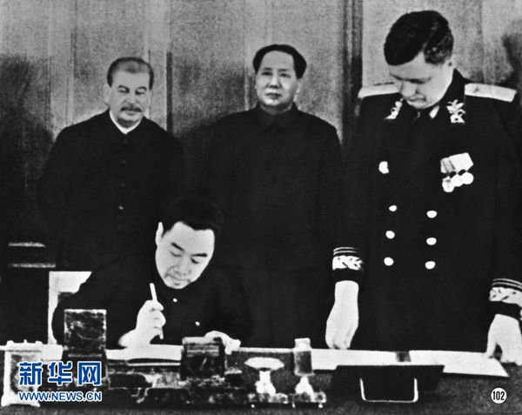
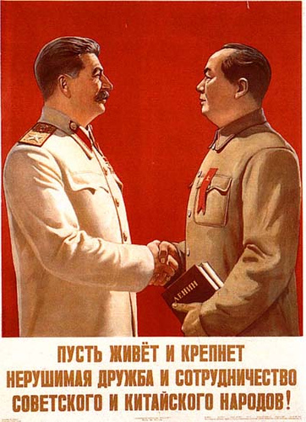
The Sino-Soviet Treaty of Alliance
In February 1950, Mao was invited to Moscow where a treaty of alliance was signed. The USSR promised economic assistance to China and protect in case of war with Japan again.
However Mao was offended at his treatment. The treaty gave China $300 million in loans but was repayable. Mao also had to recognise Soviet control over Outer Mongolia and influence in Manchuria.
Khrushchev later called it ‘an insult to the Chinese people’. Despite this, the USSR sent over 20,000 advisors to the PRC and helped construct over 200 industrial projects.

Slide 7
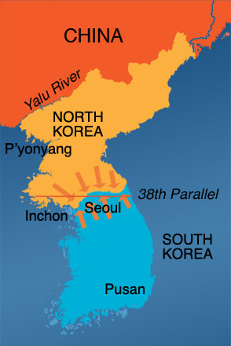
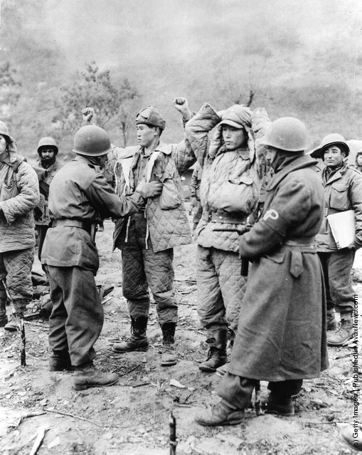
The Korean War
In November 1950, the Red Army of the PRC invaded North Korea in an attempt to push back American-led UN forces which threatened to wipe out the North Koreans.
During the war, over 1 million Chinese troops fought, with over 700,000 casualties. Even Mao’s son was killed and China had to pay back to the USSR $1.35 billion in weapons it had supplied to China.
There were even suggestions that Stalin deliberately prevented an early armistice in order to exhaust the Chinese. The armistice came quickly after Stalin’s death!

Slide 8
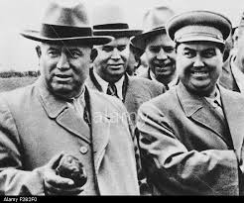
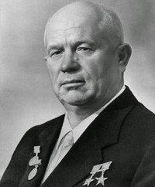
Khrushchev and De-Stalinisation
After Stalin’s death in 1953, the Soviet Union became ruled by Malenkov, Khrushchev and Bulganin. Tensions eased as the USSR began to supply China with loans and technology.
However by 1956, Nikita Khrushchev had became de facto leader of the USSR. In February, he gave a speech criticising the personality cult of Stalin and his crimes, suggesting Stalin had ‘put himself above the party’.
Mao interpreted this as an attack on himself too as he ruled China in a similar way to Stalin. This increased tensions between the two.

Slide 9
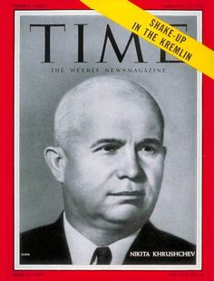
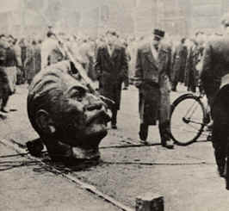
Khrushchev and ‘Peaceful Coexistence’
In 1956, Khrushchev also began calling for ‘peaceful co-existence’ and better relations with the USA to avoid nuclear war.
This indirectly led to protests across Eastern Europe as many people believed Khrushchev was promising greater freedoms. An uprising in Hungary in November 1956 was violently crushed.
Mao was angered by the failure of the USSR to control ‘reactionary forces’ and for allowing protests with the USSR.

Slide 10
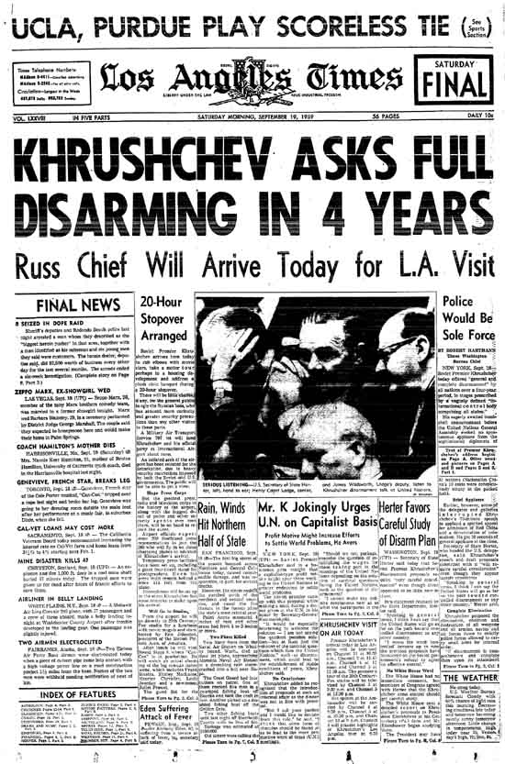
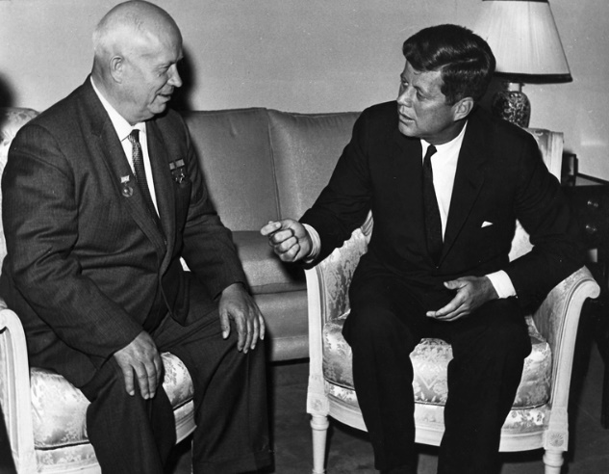
Khrushchev and ‘Peaceful Coexistence’
Mao viewed peaceful-coexistence with the West as ‘heresy’ and a betrayal of the Marxist-Leninist notion of the inevitability of war with capitalism.
Mao sincerely believed that ‘continuing revolution’ with the West was the only way to ensure the victory of Communism.
By negotiating with the West on arms reductions in the 1950s, Mao believed the USSR was becoming a ‘revisionist’ and betrayer of true Communism.

Slide 11
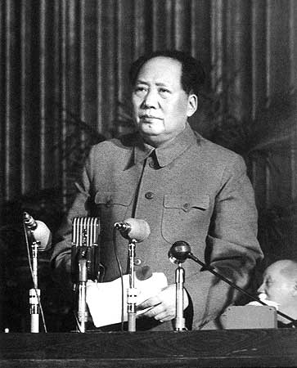
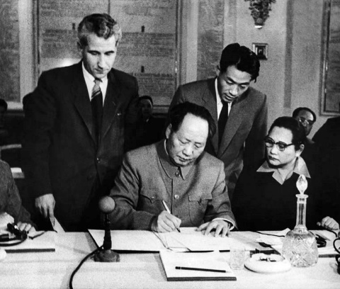
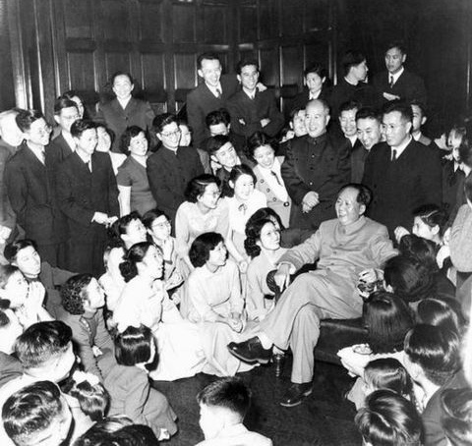
The 1957 Moscow Conference
In November 1957, Khrushchev convened a special Meeting of World Communist Parties in Moscow to celebrate the 40th anniversary of the Bolshevik Revolution and to try and resolve differences.
Despite approving a declaration that promised future co-operation, Mao made a series of speeches warning Moscow to abandon ‘revisionism’ and to return to the true Marxist-Leninist path.
In a series of speeches, Deng Xiaoping demolished the Soviet speaker, Mikhail Suslov, by arguing that world revolution was only possible through armed struggle. This angered and humiliated Moscow.

Slide 12
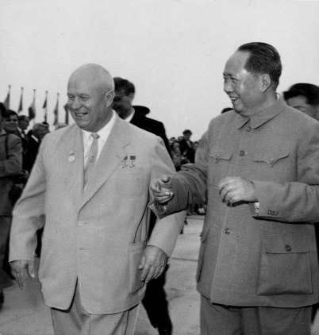
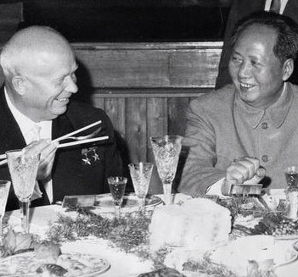
Khrushchev’s Visit to Beijing 1958
It was clear from the 1957 Moscow Conference that Mao was attempting to challenge the USSR for leadership of the international communist movement.
This was a threat to the USSR as it used the international movement as a way of spreading Soviet influence in the world.
In an attempt to improve these relations, Khrushchev visited Beijing in July 1958. Mao took his chance to humiliate Khrushchev further by arranging meetings in his swimming pool!

Slide 13
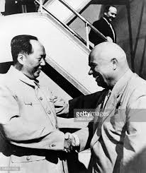
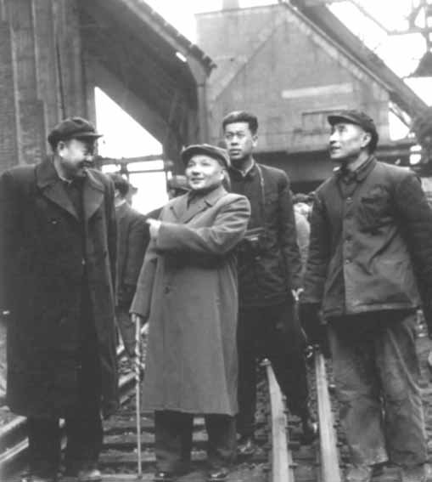
Khrushchev’s Visit to Beijing 1958
Khrushchev was also put in a hotel with no air conditioning. The talks failed dramatically.
The USSR proposed to create with China a joint fleet of submarines and radio stations on the Chinese coast. Mao interpreted this as an attempt to ‘bring China under Soviet military control’.
Deng Xiaoping again attacked the USSR, stating they were arrogant for only viewing themselves as the only true Marxist-Leninists. He even accused Soviet technical advisors in China of being spies!

Slide 14
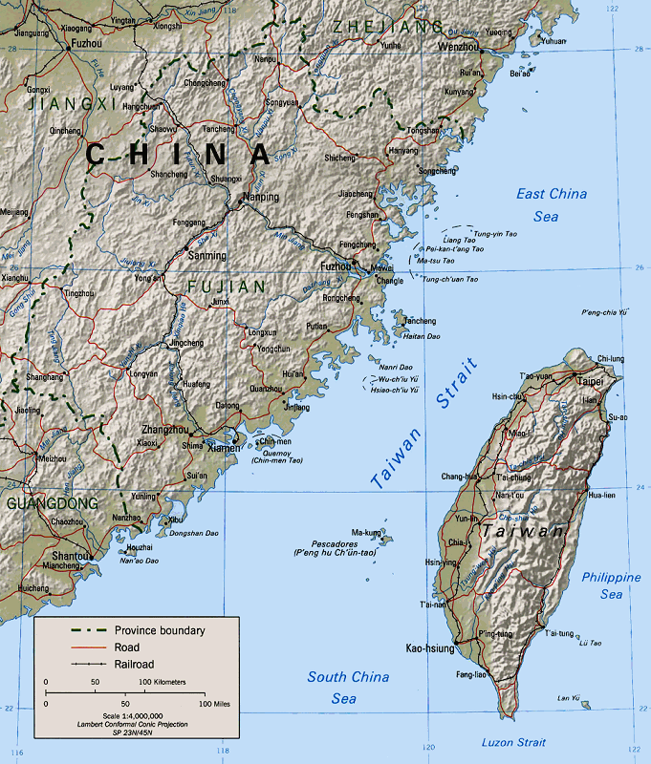
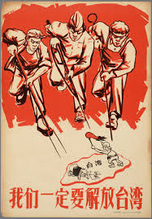
The Taiwan Crisis 1958
In this underlying atmosphere of mistrust and enmity, a crisis erupted over Taiwan in August 1958.
China began bombarding the Nationalist controlled island of Quemoy off the Chinese coast and mobilised its army for war. The USA responded by mobilising the 7th Fleet and prepared for war.
Mao launched the attack shortly after Khrushchev had left Beijing. It seemed as if Mao was trying to prove his independence from the USSR and to test the USSR’s support for China. He was also testing the US commitment to Taiwan.

Slide 15
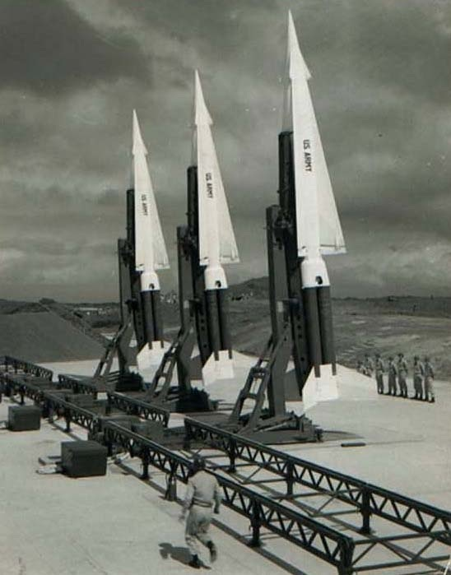
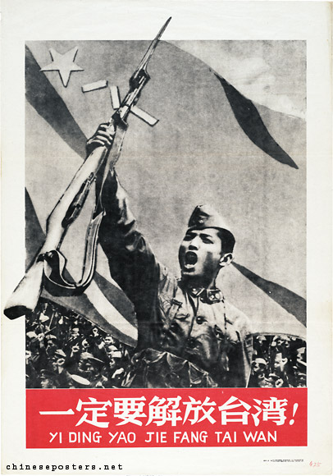
The Taiwan Crisis 1958
The crisis triggered a breakdown in Sino-Soviet relations. Mao realised he didn’t have the full support of the USSR as it took the USSR nearly two months before they warned the USA of retaliation.
Khrushchev argued that he was unwilling to put the USSR at risk by ‘testing the stability of the capitalist system’. He denounced Mao as a ‘Trotskyist’ who had lost sense of reality.
In response the USSR withdrew all its technical and scientific advisors from China in 1959 and ended all military cooperation, including nuclear.

Slide 16
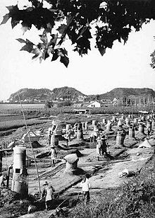
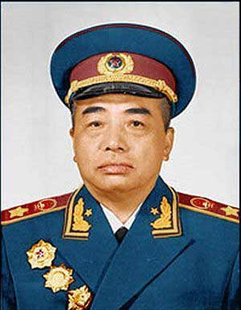
The Great Leap Forward 1958-61
With relations declining, a war of words between the two nations soon developed. The increasing failure of Mao’s ‘Great Leap Forward’ economic plan was criticised by the USSR. It had led to famine and economic collapse within China.
The Soviet press called it ‘faulty in design and erroneous in practice’ and denounced Mao. This enraged Mao who was further angered by rumours that Marshal Peng Dehuai had passed on details of the famine to the USSR.
He was purged by Mao during the July 1959 Lushan Conference.

Slide 17
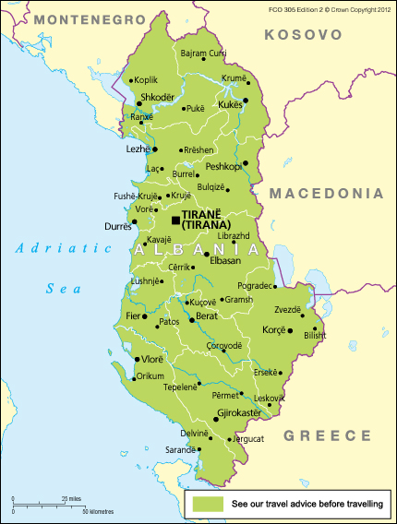
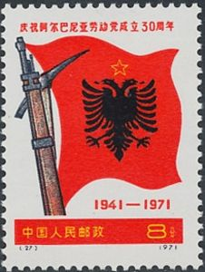
Soviet-Albanian Split 1961
With the relationship between the nations in tatters, Mao took any opportunity to further embarrass the USSR and take leadership of the world communist movement.
When the USSR began withdrawing financial aid to Albania in January 1961, China immediately stepped in to supply Albania with technical and financial assistance.
Mao was attempting to prove the leadership of China as the true leader of the Communist world. Albania had also criticised Khrushchev for his ‘revisionism’.

Slide 18
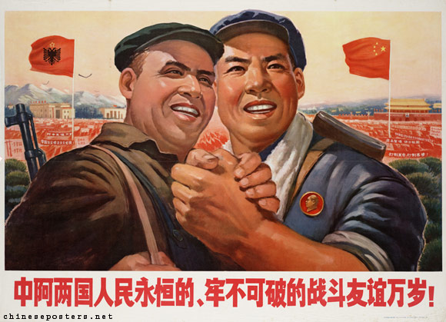

Slide 19
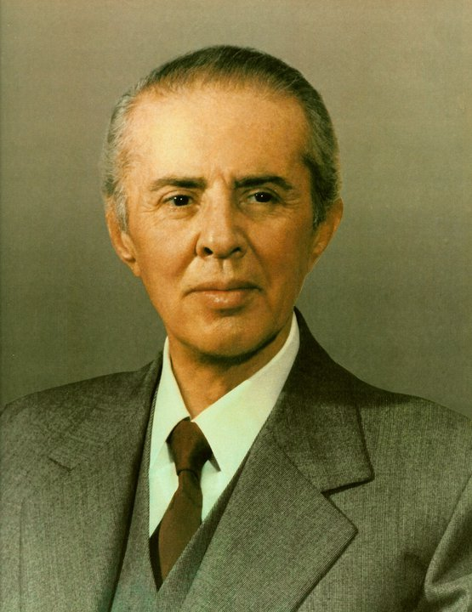
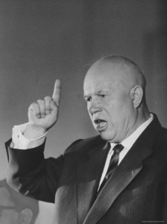
The End of Diplomatic Relations 1961
The move to support Albania was a clear challenge to Soviet influence in Europe. Matters came to ahead at the 22nd Congress of the CPSU in Moscow in October 1961.
Khrushchev attacked Albania’s leader, Enver Hoxha, for his Stalinist ways which was also interpreted as an attack on China. In response, Zhou Enlai dramatically staged a rehearsed walk-out of the Congress.
This ended diplomatic relations between the two nations. Khrushchev called Mao an ‘Asian Hitler’ and Mao called Khrushchev ‘a redundant old boot’.

Slide 20
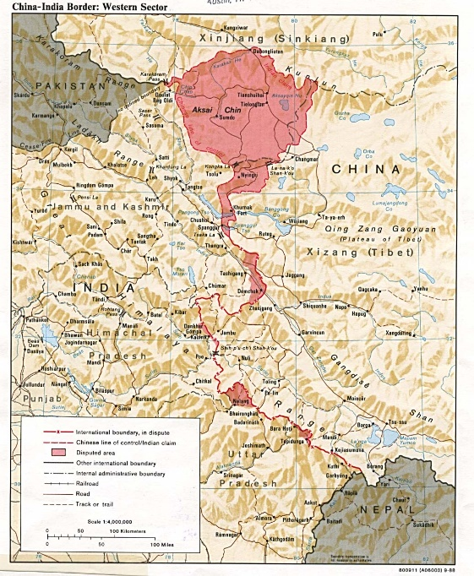
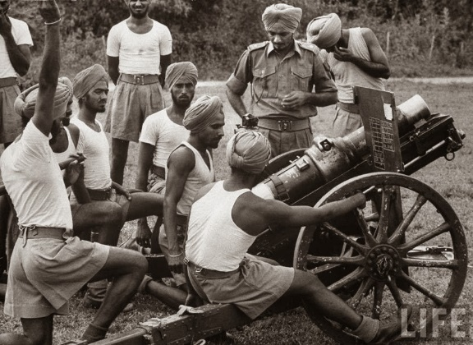
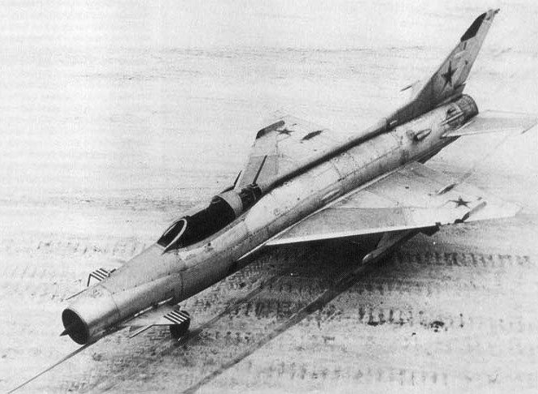
The Sino-Indian War 1962
With diplomatic, economic and military relations ended between the two powers, it wasn’t long until the rivalry became hostile.
In October 1962, a dispute over the Tibetan border between India and China broke out into fighting. The war ended in November with China taking disputed areas.
Although officially ‘neutral’, the USSR had supported India by selling MIG fighter jets. Mao refused to allow the Soviet negotiator, Kosygin, to mediate the ceasefire.

Slide 21
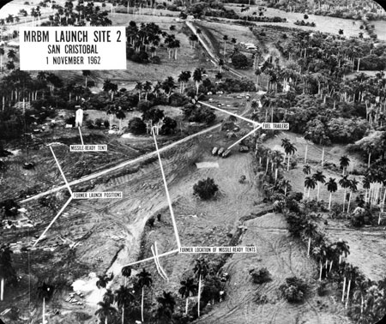
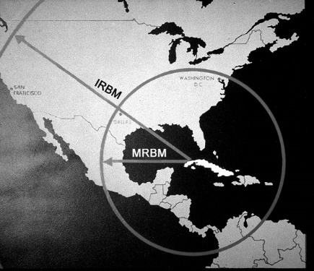
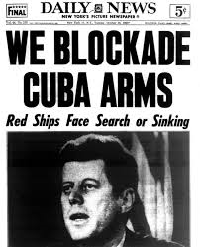
The Cuban Missile Crisis 1962
In the same month, the Cuban Missile Crisis erupted when Soviet ballistic nuclear missiles were spotted by the US on Cuba.
After a tense stand-off, Khrushchev backed-down by removing the missiles. Mao took the opportunity to attack the USSR.
He attacked the USSR for its ‘adventurism’ in placing missiles on Cuba and its ‘capitulationism’ in cowardly backing down. For Mao, this was a further example of the USSR’s inability to lead world communism.

Slide 22
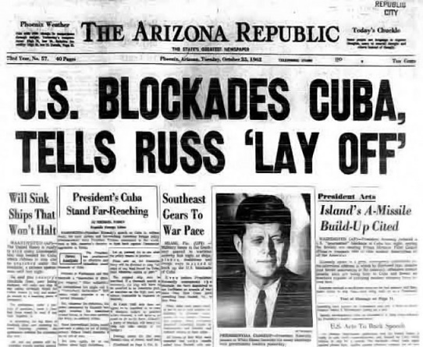
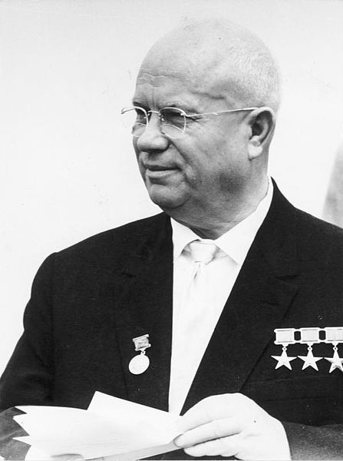
The Cuban Missile Crisis 1962
The Cuban Missile Crisis had shown Mao that the USSR was wrong in its revisionist policy of ‘peaceful-coexistence’. By backing down, the USSR was ‘helping’ the imperialist powers.
Khrushchev responded to Mao by stating: ‘We might ask the Chinese: What right have you to decide for us questions involving our very existence and our class struggle? We too want socialism, but we want to win it through class struggle, not by unleashing a world thermonuclear war.’

Slide 23
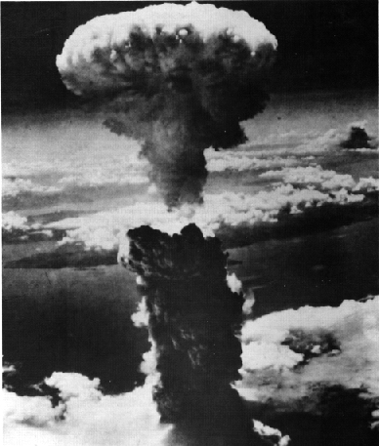
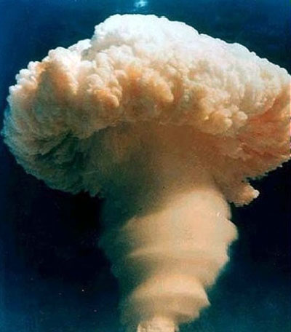
The Nuclear Issue 1963-64
Ever since the 1950s, Mao was frustrated by the attitude of the USSR in sharing its nuclear weapons.
The USSR only agreed to give China a nuclear deterrent if China allowed the USSR to control its use. This Mao could not agree to.
After Soviet nuclear cooperation was withdrawn in 1959, Chinese nuclear physicists managed to piece together hundreds of shredded documents on nuclear technology!

Slide 24
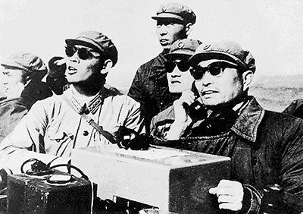
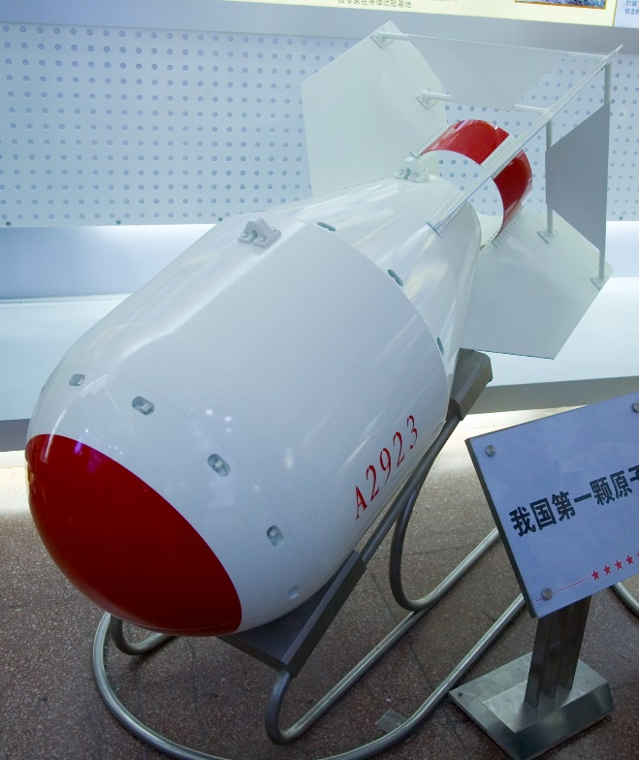
The Nuclear Issue 1963-64
This knowledge enabled China to press ahead with developing its own bomb. However in 1963 the USSR and USA signed the Test Ban Treaty which suspended the atmospheric testing of nuclear bombs.
Mao saw this as another betrayal of the USSR and an attempt to ensure that China could not develop its own weapons.
Despite this, in 1964 China detonated its first atomic bomb. It was now a superpower. The bomb was codenamed ’59/6’ after the year and month that Soviet atomic advisors had been withdrawn!

Slide 25
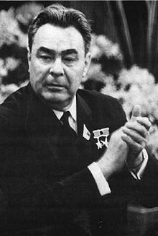
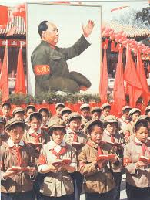
The Cultural Revolution 1966
After Khrushchev was forced to stand-down from office in 1964, he was replaced by Leonid Brezhnev who would rule until 1982.
Brezhnev continued to try and isolate China within the worldwide communist movement, accusing it of sending supplies to the USA in Vietnam.
During the anarchy of the Cultural Revolution, the USSR argued that it was just another example of China’s ‘fanaticism’ that threatened to destroy the world.

Slide 26
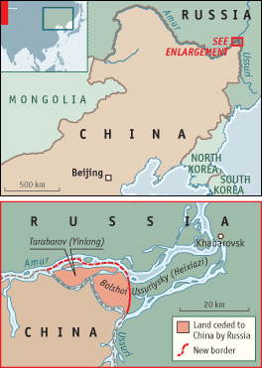
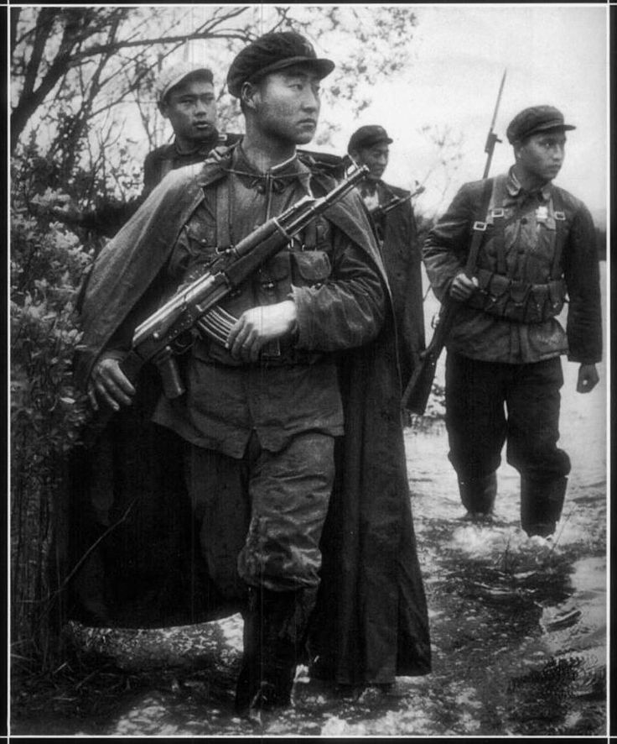
Sino-Soviet Border War 1969
By the end of the 1960s, the Sino-Soviet relationship had become increasingly belligerent. Both sides now had nuclear weapons and both continued to criticise each other.
In 1967 China developed its first hydrogen bomb and the USSR became increasingly concerned. The USSR had stationed over 50 divisions along its China border.
On 2nd March 1969 tension boiled over into fighting on the island of Damansky in the Ussuri River. The fighting intensified throughout the summer.

Slide 27
Sino-Soviet Border War 1969
Mao ordered that tunnels be dug and preparations made for nuclear war. Both sides realigned their nuclear missiles to face each other.
The USSR even secretly asked the USA what the US would do in the event of a Soviet nuclear attack on China!
The conflict marked the lowest point in relations. It forced China to consider better relations with the USA as a way to offset the Soviet threat.

Slide 28
The Vietnam War
Another source of tension between the two nations occurred during the Vietnam War which ended in 1975.
Both sides tried to win support and influence over the Vietminh. This would give either side influence in the world as the main ‘champion’ against US imperialism.
The USSR gained the most influence after supplying North Vietnam with military equipment. In 1978 the USSR signed a military alliance with Vietnam.

Slide 29
Chinese support for Cambodia 1975
China attempted to make up for this strategic defeat by forming a closer relationship with Pol Pot’s Khmer Rouge party in Cambodia.
The Khmer Rouge were a ‘Maoist’ party supported by the PRC. Between 1975-79 the regime murdered over 2.5 million people. China didn’t seem to mind.
In December 1978, the USSR-backed Vietnam invaded Cambodia stating ‘regime change’ as its aim. Vietnam expelled all Chinese people. In return, China called the invasion ‘Soviet expansionism’.

Slide 30
Chinese Invasion of Vietnam 1979
In response to the overthrow of its pro-Chinese puppet state in Cambodia, China launched an invasion of Vietnam on 17th February 1979 in order to protect Cambodia.
At the United Nations, both sides declared the other was the aggressor and the USSR declared its intervention was on ‘humanitarian grounds’.
The PLA was forced to withdraw under heavy casualties after months of fighting. It was a major propaganda defeat for China.

Slide 31
The Invasion of Afghanistan 1979
In 1979 the USSR had invaded Afghanistan to prop-up its influence in the area. China responded by sending supplies to Mujahideen fighters who were resisting the Soviet invasion.
Despite the fact that Mao had died in 1976 and was replaced by the more moderate Deng Xiaoping, fears over Soviet encirclement of China prevented any moves towards a better relationship.

Slide 32
Sino-Soviet Détente 1985
By 1985, new Soviet leader Mikhail Gorbachev had come to power, promising to reform the USSR and end to occupation of Afghanistan.
Gorbachev’s policies led to new negotiations with China. In 1986 trade agreements were signed and in May 1988 a cultural exchange agreement was completed.
Gorbachev was finally invited to Beijing in 1989 after announcing the withdraw of Soviet troops from Afghanistan.

Slide 33
Tiananmen Square Massacre 1989
Since 1985, Sino-Soviet relations had improved as both nations had embarked on government reforms and both wished to end hostilities.
Gorbachev’s policies of ‘Perestroika’ (economic restructuring) and ‘Glasnost’ (political freedom) unleashed forces within the USSR that led to its eventual collapse in 1991.
Deng Xiaoping’s ‘four modernisations’ sought to introduce state-controlled capitalism into China. However the violent crushing of the Tiananmen Square protests showed that China was unwilling to allow ‘democratic reform’.

Slide 34
Conclusions - Interpretations
The Sino–Soviet split is one of the most difficult areas of twentieth century history to study, largely because historians have had little access to documentary evidence and thus have been forced to rely on official statements from the two protagonists. This situation is now beginning to change and the books in the reading section reflect this.
The lack of clear evidence about the origins of the split have led to a number of theories being developed to explain why it took place. You should, however, be wary of any mono-causal explanation when examining the causes of the Sino–Soviet split in the 1950s and how its widening in the 1960s affected international relations.

Slide 35
Conclusions - Interpretations
There are five ways major in which the Sino-Soviet split can be perceived:
As the inevitable result of Sino-Soviet rivalry in East Asia
As an ideological clash over the correct interpretation of Marxism-Leninism
As part of a different tradition of Chinese opposition to imperialism
As the result of different policies towards the West in the Cold War
As a result of rivalries between Mao and Khrushchev

Slide 36
Conclusions - Interpretations
Interpretations of the Sino–Soviet split can on the whole be divided between those that see it as the result of a traditional clash of great power interests and those that seek a more theoretical approach and look at factors such as clashes over ideology and the nature of imperialism.
The books produced in the 1960s and 1970s tended to reflect the former view and were influenced by the ‘realist’ theory of international relations. However, the increasing availability of Chinese sources, including secret speeches by Mao, have allowed historians to concentrate more on the importance of ideological issues and the stress put by the Chinese on the struggle against imperialism.
The latter is important not just because it led to differences with the Soviet Union over policy towards the USA and the newly independent states of Asia and Africa, but also because the Chinese Communist Party (CCP) increasingly accused the USSR of acting towards China in an imperialist manner.

Slide 37
Lorenz M. Luthi. (2008). The Sino-Soviet Split
“The newly available documents point to the role of ideology in the Sino-Soviet split. Both Chinese Communists and the Soviets were true believers in Marxist-Leninism. The discord between Beijing and Moscow arose over the method of establishing a socialist society domestically, and over the joint policy of the socialist camp toward the capitalist world. Further-more, while ideology was central, it increasingly became entangled in internal politics. Leadership conflicts led Mao Zedong to exploit the worsening of Sino-Soviet relations for his own goals, abroad and at home.”

Slide 38
Maurice Meisner. (1999). Mao’s China and After
“Russian anger over the Great Leap Forward and the Chinese abandonment of ‘the Soviet model’ coincided with Chinese resentment over the absence of Soviet support in the Quemoy-Matsu crisis of 1958 and border disputes with India in 1959. Khrushchev’s visit to Beijing in 1959, coming directly after his ‘summit’ meeting with President Eisenhower, his public ridicule of communes, and the Peng Dehuai affair, served only to exacerbate the hostility between the two countries and between Mao and Khrushchev personally.”

Slide 39
Gaddis, J.L. (2008). The Cold War: A New History
“The sources of Sino-Soviet tension lay, first, in the long history of hostility between Russia and China, which commitment to a common ideology had only partially overcome: Khrushchev and Mao had all the instincts and prejudices of nationalists, however much they might be communists.” (p. 140-141)
“…picking fights abroad – whether with adversaries or allies – was [for Mao] a way to maintain unity at home, a major priority as he launched the Great Leap Forward.” (p. 141)

Slide 40
Radchenko, S. (2010). The Sino-Soviet Split. In O. Westad, M. Leffer (eds), Cambridge History of the Cold War
“Between 1958 and 1962, Khrushchev's disastrous handling of the Soviet relationship with China had seriously exacerbated the tensions in the alliance. He had angered Mao Zedong with his inconsiderate proposition to build a joint submarine flotilla and a military radio station on China's soil. He had tacitly supported India in the 1959 Sino-Indian border war. In 1960, he had hastily withdrawn Soviet from China in a fit of rage. He had rallied his allies in Europe to criticize China in international forums. He had pulled out of a deal to deliver a prototype atomic bomb to the and had desperately tried to stall the Chinese nuclear weapons program. From the Chinese perspective, these policies consistently spoke of Khrushchev's handed arrogance and his chauvinistic disdain for China.”

